Slide 1
Effect of Background Color and Product Color Coordinated Displays on Consumer Satisfaction and Purchase Intention
Ahmad Saquib Sina, Juanjuan Wu
University of Minnesota, USA

Slide 2
Background color
Warm vs. Cool color
Product Color coordinated display
Products grouped by color vs. products not grouped by color
Satisfaction
Purchase intention

Slide 3
Objectives
The main objectives of this study is to
investigate the effects of background color and color coordinated displays on consumers’ satisfaction and purchase intention
compare aging consumers (55 or above) and younger consumers (undergraduate students, between 18 to 23) in their response to the stimuli to add an additional layer of information regarding age

Slide 4
Literature review
Background color
Color families (warm/cool) influence consumers’ pleasure, arousal, satisfaction, and behavioral intentions. Cool color induces pleasure and warm color induces arousal (Roschk et al., 2017)
When the temperature of color increases, it negatively impacts both classical and expressive aesthetics (Coursaris and Osch, 2016)

Slide 5
Literature review
Product color coordinated display
Product coordination refers to the way products are grouped based on similar characteristics such as color, style, and texture (Wu et al., 2013). This study groups products based on the warmness or coolness in color.
Consumers rely on heuristics to process the information if products are arranged with different colors. It is difficult for them to reach a decision and ultimately consumers choose the middle one, which is called compromise effect (Kim et al., 2017).

Slide 6
Literature review
Younger and aging consumers
Aging consumer becomes more risk aversive and they react the same level of perceived risk more sensitively than younger consumers (Kown and Noh., 2009)
The relation between emotional value and satisfaction is stronger for aging consumers than younger consumers (Kumar and Lim, 2008)

Slide 7
Literature review
Younger and aging consumers
On the other hand, the relation between economic value and satisfaction is stronger for younger consumers than aging consumers (Kumar and Lim, 2008)
Age has significant negative effect on fashion clothing involvement. Younger people place more emphasis on their appearance than aging people (O’Cass, 2003).

Slide 8
Methodology
Sample
A total of 200 US consumers took part in this study. 100 of theme were aging consumers and the remaining 100 were younger consumers.
Participants recruited through M-turk

Slide 9
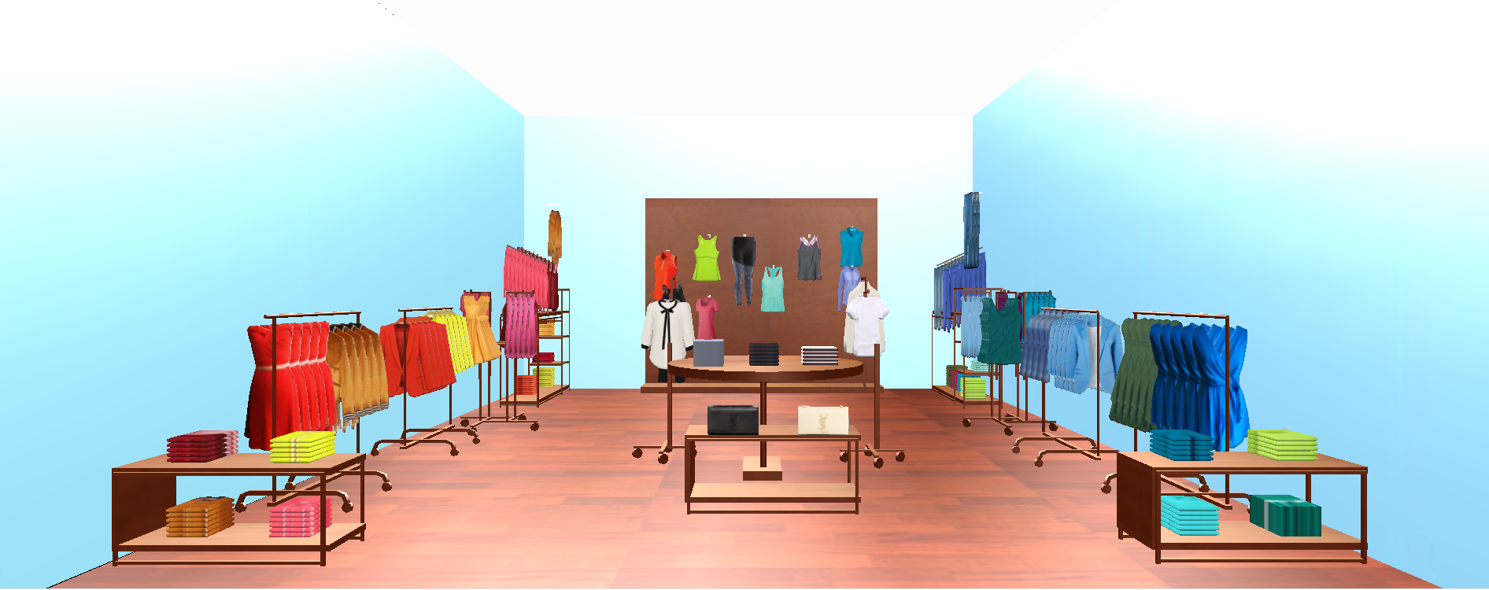
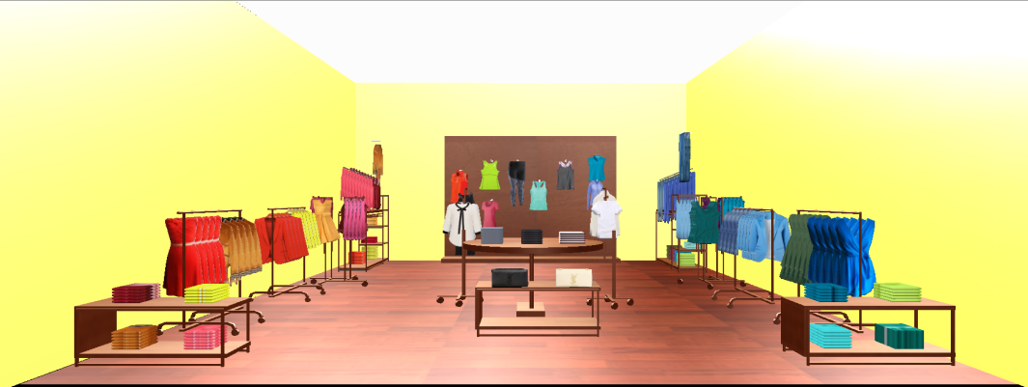
Methodology
Stimuli
Cool and Warm colors background and product color
coordinated display

Slide 10
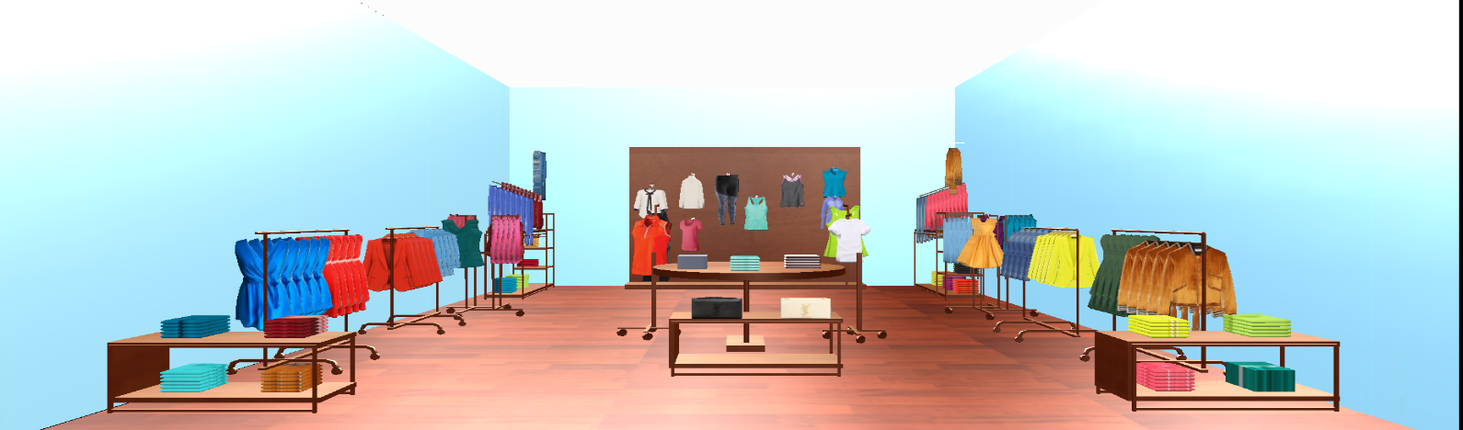
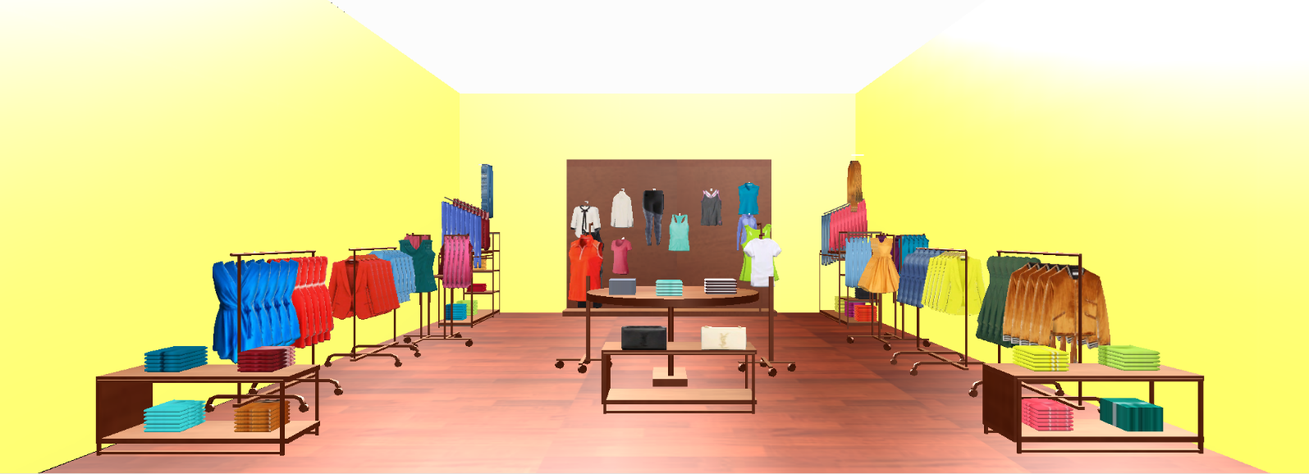
Methodology
Stimuli
Cool and Warm colors background and product display
grouped by different types of colors

Slide 11
Methodology
Procedure
2 (Background color: Warm x Cool) x 2 (products grouped by color vs products not grouped by color) experimental design
Four stimuli were developed using Mockshop – a 3D virtual retailing software package and participants were equally distributed among the stimuli
7-point Likert scale was used for this study

Slide 12
Instrumentation
Satisfaction (Magi, 2003), 0.93
Purchase intention (Baker et al., 2002), 0.83

Slide 13
Results
Manipulation analysis
Multiple regression analysis was used to test all hypotheses.
MANOVA analysis showed that participants noted significant differences in the product display grouped by colors (F = 8.246, p < .001) and the product display not grouped by colors (F = 2.546, p < .05)

Slide 14
Results
Hypothesis testing
Fitted regression models showed that the cool background color creates higher satisfaction (coefficient= 0.058*, p< 0.05) than warm background color. There is no significant differences for purchase intention.
Products grouped by color display enhances higher satisfaction (coefficient= 0.06*, p< 0.05) and purchase intention (co
efficient = 0.07**, p < 0.05) than products not grouped by color display.

Slide 15
Results
Comparison among four different product displays
Post hoc Dunntt t (two-tailed) test demonstrated that cool background color and product display grouped by colors creates higher satisfaction and purchase intention than warm background color and product display not grouped by colors (MD=1.28, p<0.05) and cool background color and product display not grouped by colors. (MD=1.06, p<0.05)
We did not find significant different for other product display methods.

Slide 16
Results
Interaction effect of age
MANOVA results revealed a significant interaction between product display methods and age for both satisfaction (F=8.32, p<0.01), and purchase intention (F=5.42, p<0.05)
Younger consumer showed more satisfaction (t=2.87, p <.050 and increased purchase intention (t=1.32, p <.05) for the cool color background and product display grouped by colors over warm color background and product display not grouped by colors.

Slide 17
Results
Interaction effect of age
For the aging consumer, there were no significant different between the conditions (p<0.05)
Younger consumers (M=4.5, p<0.001) showed higher preferences for the cool background and product color coordinated display than the aging consumers (M=3.6, p<0.001).

Slide 18
Discussion and Conclusion
The results of this study provides evidence that background color and product display grouped by colors or not influence satisfaction and purchase intention.
Product color coordinated displays work better in a cool environment for the young consumers. On the other hand, the display methods did not significantly influence aging consumers.

Slide 19
Discussion and Conclusion
The implication of this study is that retailers need to think about both interior background color and product color when playing with the design element color
Additionally, future research could consider an empirical study to investigate the moderating effect of some important factors such as fashion involvement, shopping motivations on background color and product display method.

Slide 20
?

